Slide 2
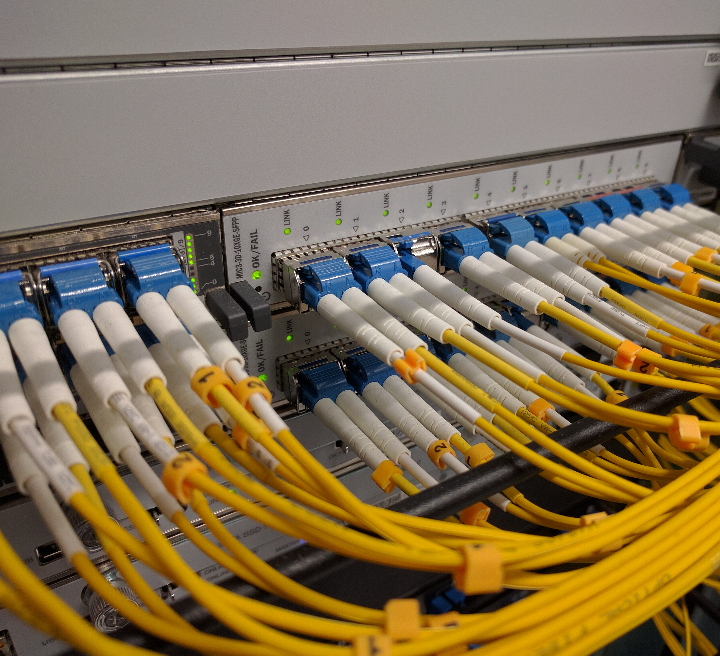
Lunchtime series ‘19 – 17 APR
Intelligent network performance metrics
Richard procter
richard.procter@reannz.co.nz

Slide 3
NET-BA-0109
UOO-MA-1042

Slide 4
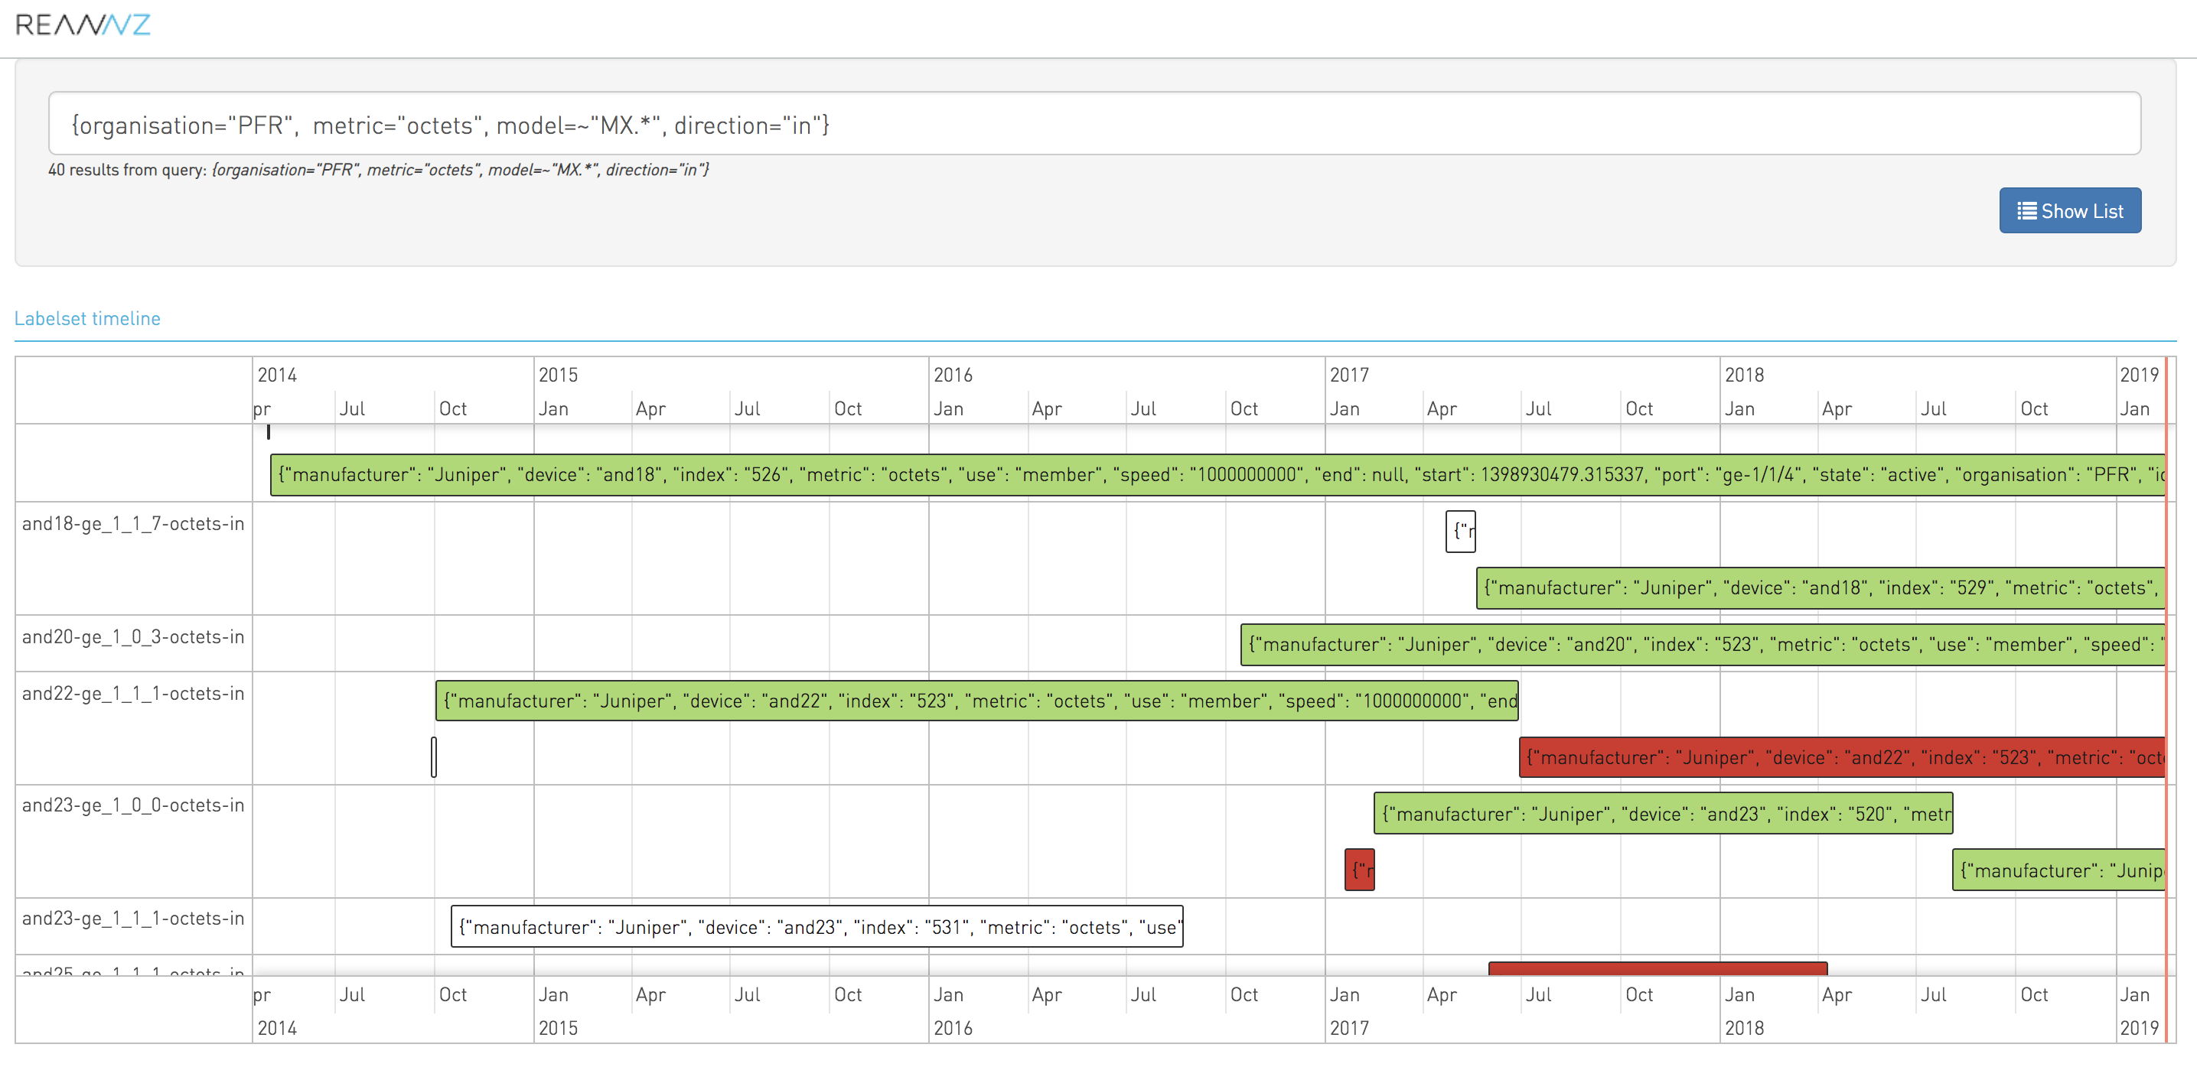

Slide 5
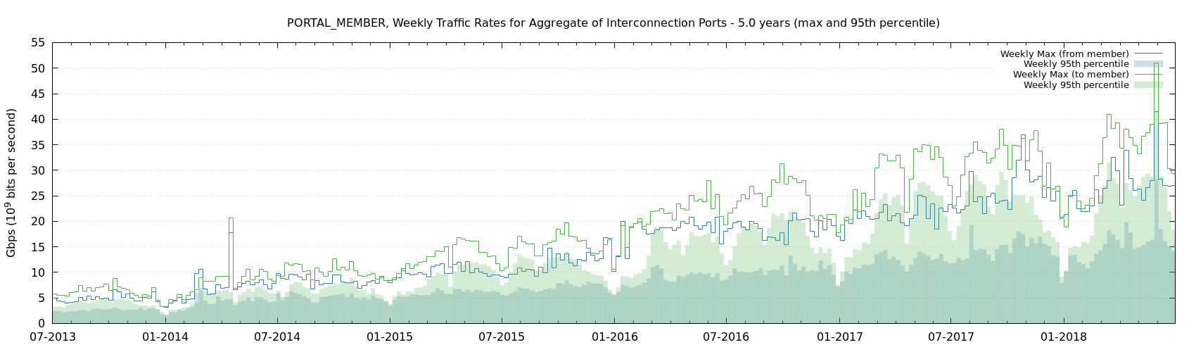

Slide 6
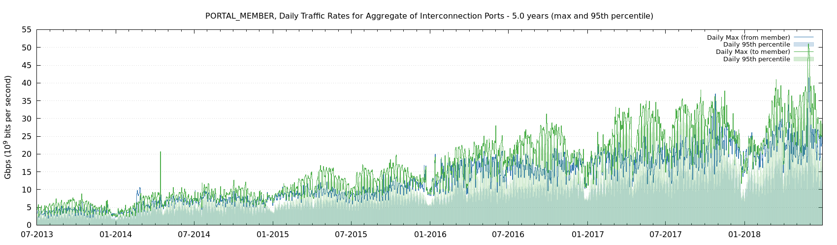

Slide 7
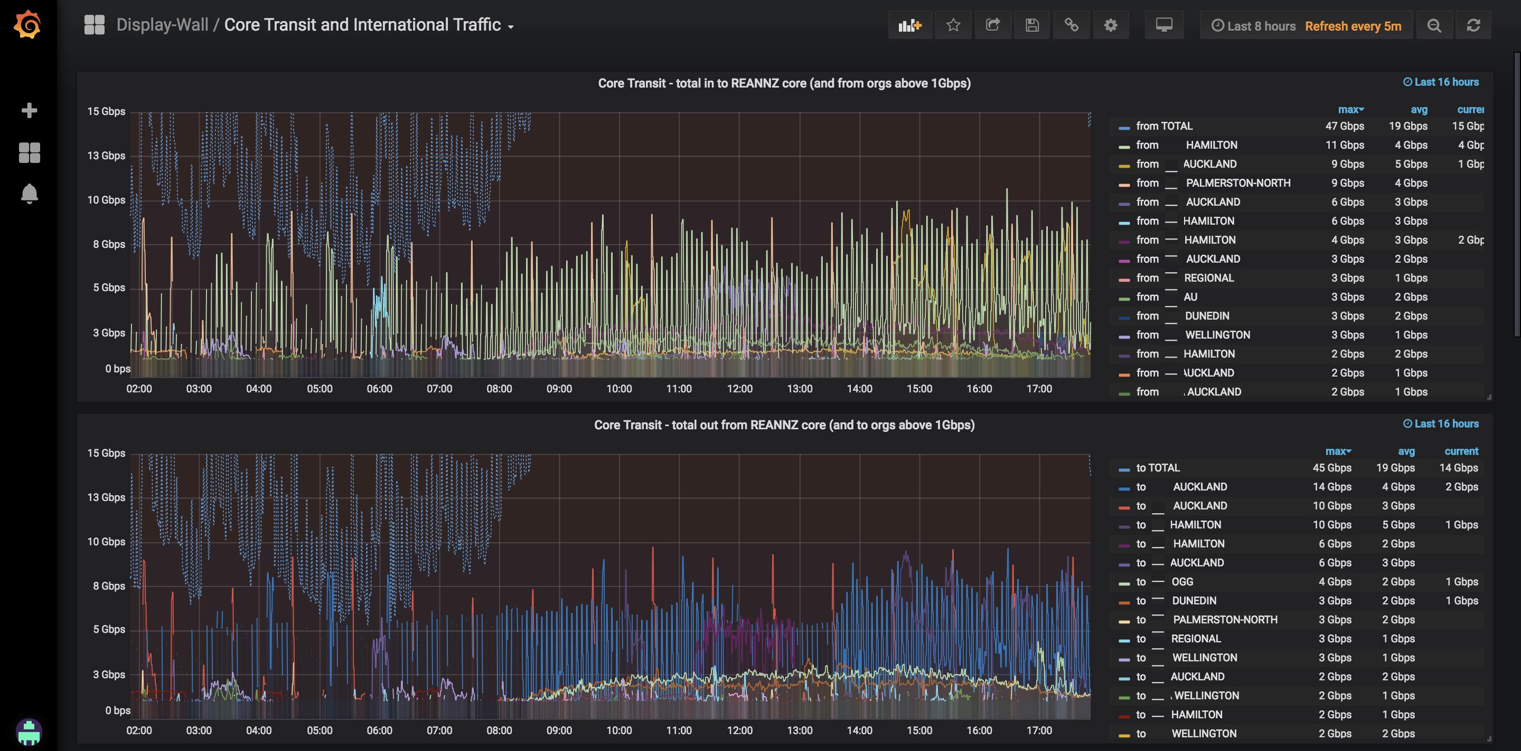

Slide 8
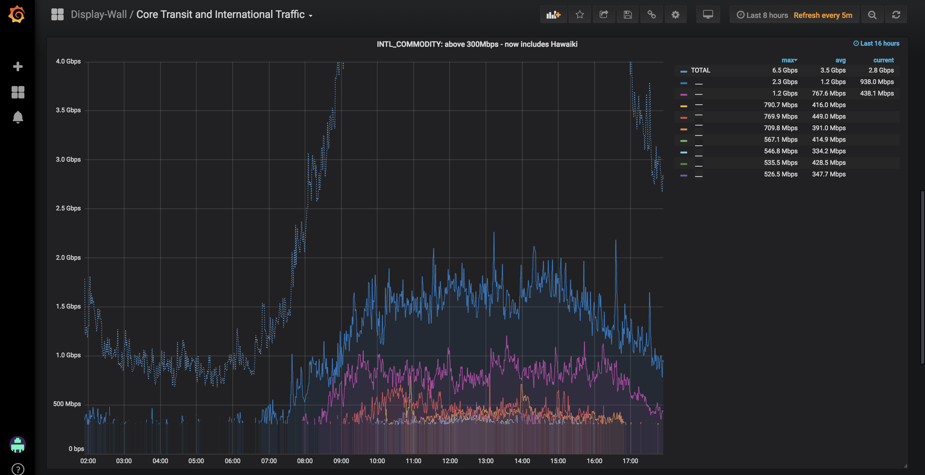

Slide 9
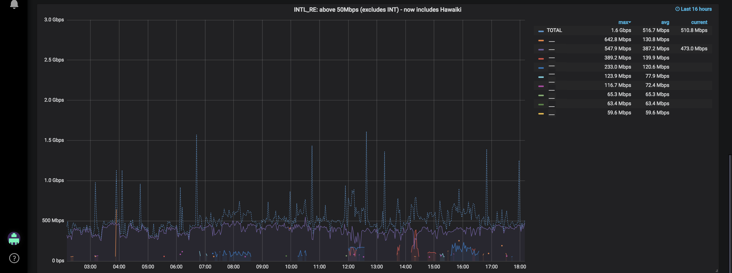

Slide 10
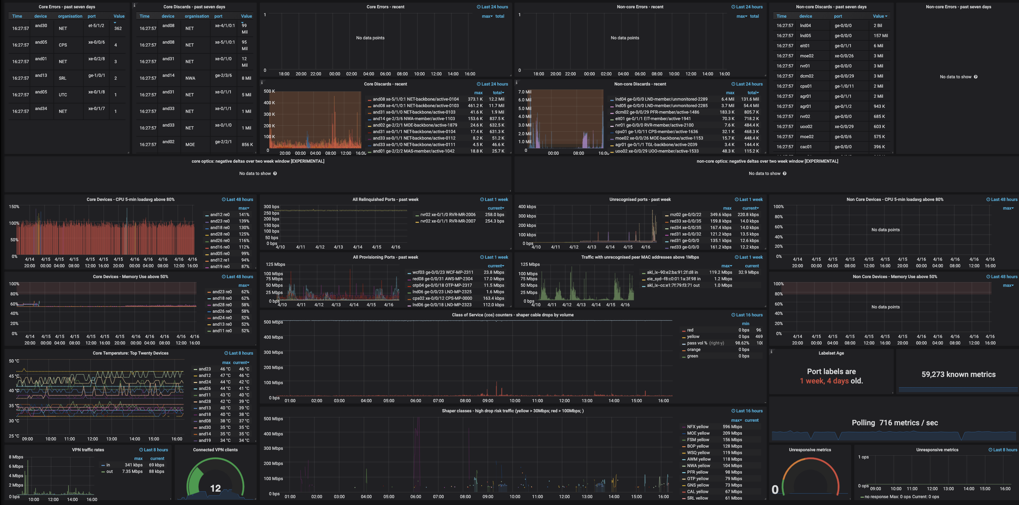

Slide 11
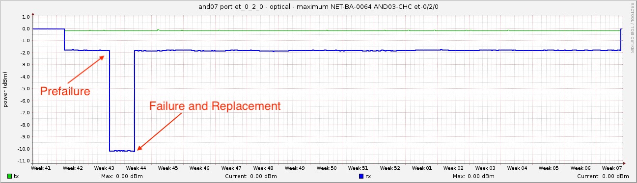
sum by (device, port, organisation)
(delta(raw_optical{device=~"and.*", direction="in", state="active"}[2w]))
<= -2.75 > -15

